Slide 2
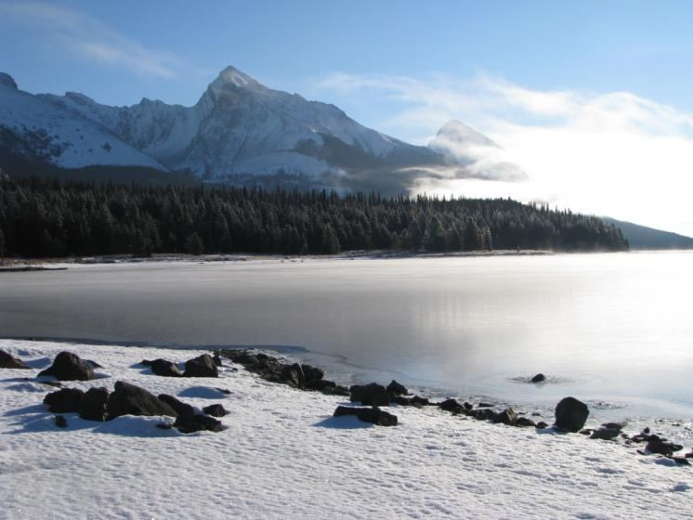
SCOPE OF WORK
Backcountry Media Review
First phase
7 Mountain Parks
Glacier, Mt. Revelstoke, Waterton, Jasper, Banff, Kootenay, and Yoho
Review process :
Research & recreation trends
Media sampling
Inventory and evaluation
Interviews with frontline staff
Recommendations for media design and coordination
Notes:
Methods of EC – this is where your input is key today, at this early stage of the project.
Discuss excel sheet and criteria, goals of brochures(jean and aina), fit(see fire mgt media, interp, ), marketing vs information tool
Reality – funding to carry out recommendations, staff acceptance, national brand initiatives
User surveys – need to gather existing information on #’s, trends, demographics, etc, what does parks have, how far we go?
Broad scope – discuss priorities, national park pride theme(jeans torch carry)
Additions, interviews(Rob, …)

Slide 3
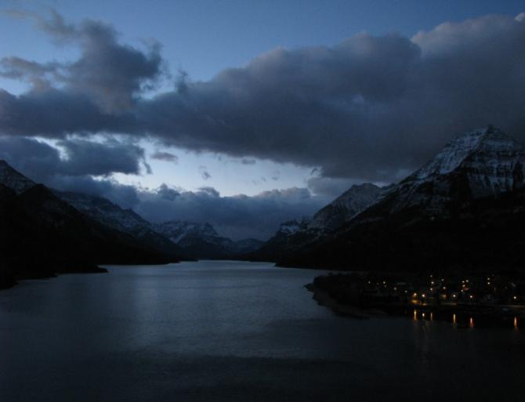
RESEARCH
The new national brand
- Changing focus towards visitor experience
- Web renewal process nearing completion
Recreation Trends & User Surveys
Inventory
- Print, web, trailhead kiosks
Park staff interviews
- Visitor services
- Backcountry specialists
- Communications
- Steering committee
- Specialists

Slide 4
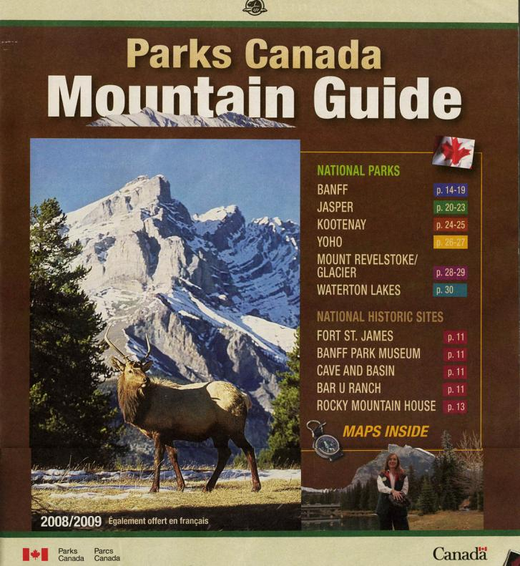
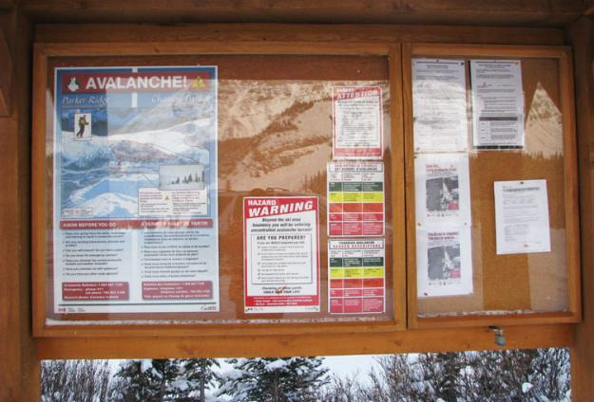
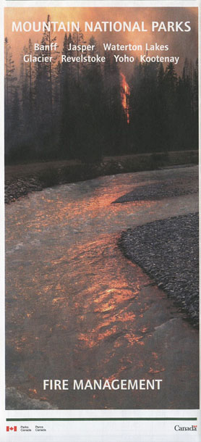

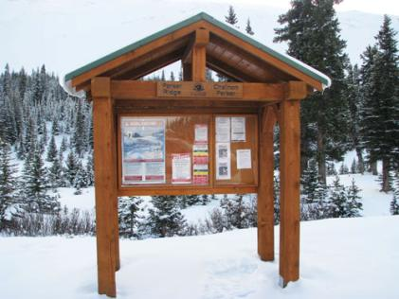
IN PARK INVENTORY

Slide 5
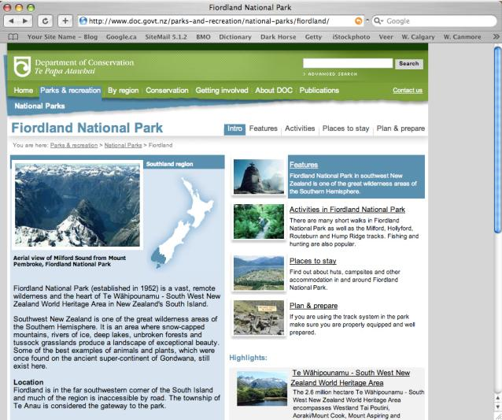
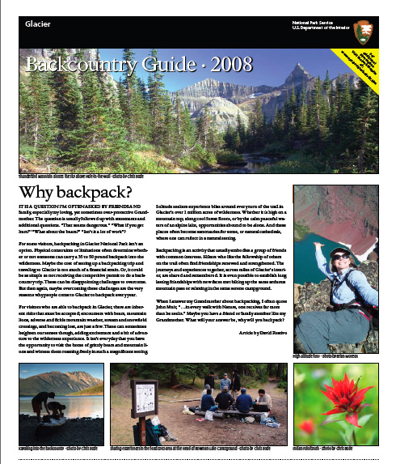
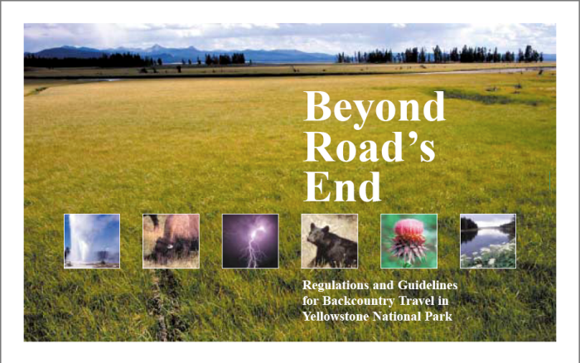
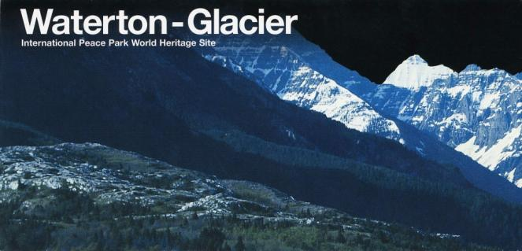
EXTERNAL SAMPLING
Notes:
Us SAMPLE, WEB PAGES THAT WORK

Slide 6
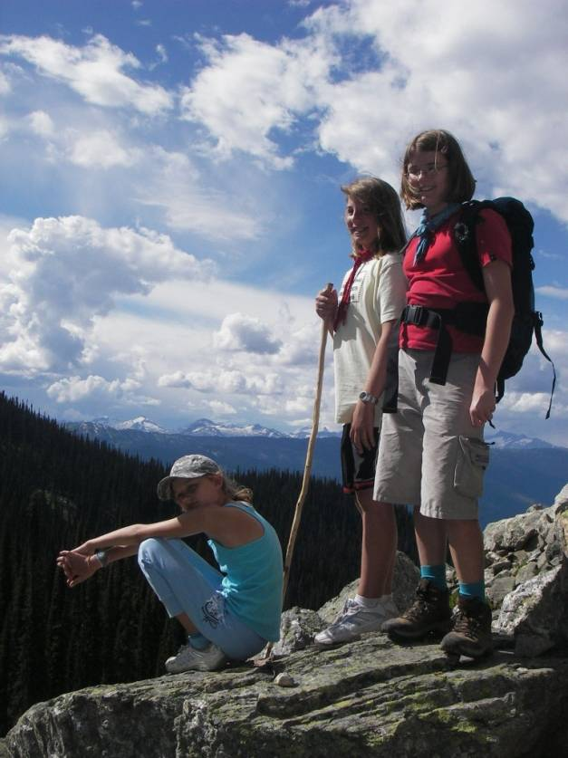
RECREATION TRENDS & SURVEYS
User trends
- Parks Canada surveys
- Staff interviews
- MTCA Trails Strategy
Activity
- Mountain biking still an increasing demand
- Trail running is popular
- Signature destination trails are being marketed
- Interconnected trail systems being developed in communities
- Increased trail use by pet owners
- Aging user – over 55
Information needs
- Desire for readily available, user friendly, high quality information
- Liability issues increasing = need for access to info to reduce risk
Notes:
Ask audience – what is the signature destination trail in their park

Slide 7
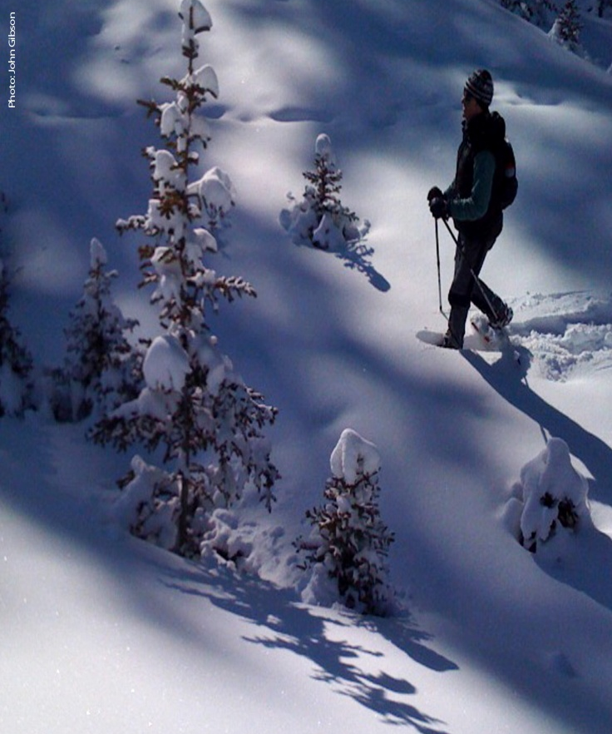
FRONT LINE STAFF INTERVIEWS
Availability
  Web access needs improvement
  When the Visitor Reception Centres are closed
  1-800-NUMBER, other access, virtual hike
Popularity and customer feedback
Most popular is the backcountry guide, or newsletter,
Jasper Summer Trails, Lake Louise area trails.
User trends:
  Activity – snowshoeing, ski touring, adventure sports, trail running, biking, winter activities
  Expectations – rising expectations for quality, accessible information
  Pre-planning – more pre trip planning at home
  New Canadian visitors increasing
  Duration of trip – shorter duration, 2 to 3 day trips vs longer multiday trips

Slide 8
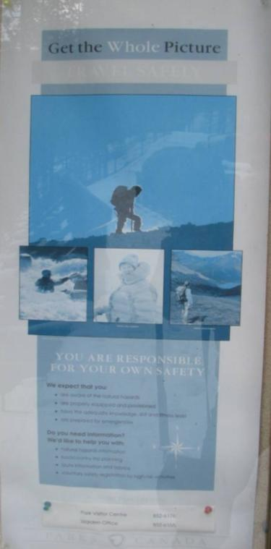
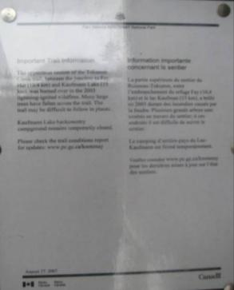
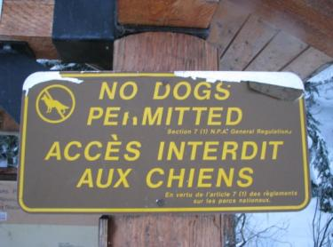
FRONT LINE STAFF INTERVIEWS
    User needs
    By activity
    Info on current trail conditions
    By message
    Visitors need information at all levels, one on one counseling is important, all of the information presented is valuable
    Safety message must be on all pieces
    Some information is not needed on trailhead sign kiosks
    `LESS, LESS, LESS`
Notes:
1

Slide 9
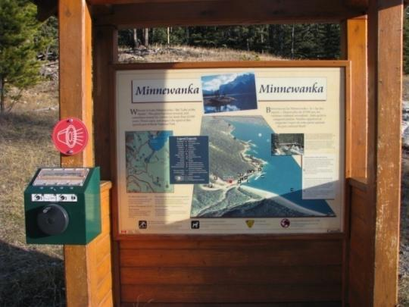
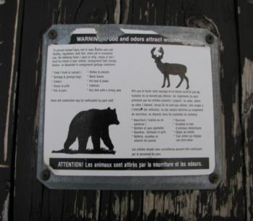
FRONT LINE STAFF INTERVIEWS
Access / Design / Condition
- There are great examples Parks has created
- Consistency in design is important
- Updating required on sign kiosks
- Add information on intranet
- In park design and updating is common
- Park by park requirements vary
Priorities suggested by staff
- Terms of reference/design guidelines a must
- Templating required for print and sign media
- Recommendations need to be carried through
- A dedicated staff member would assist in consistent messaging on sign kiosks
Notes:
Jean is next

Slide 10
BROCHURE EVALUATION CRITERIA
Target Audience
Purpose/Goals and Categorization
Consistency
Mandate support (Protection, education, experience)
Hierarchy
User Friendly Design
Charts and Maps
Graphics
Photos
Size, Paper, Printing, Templating & Cost Effectiveness
Links, Resources & Important Information
Publication Date
Availability
Green
User Feedback

Slide 11
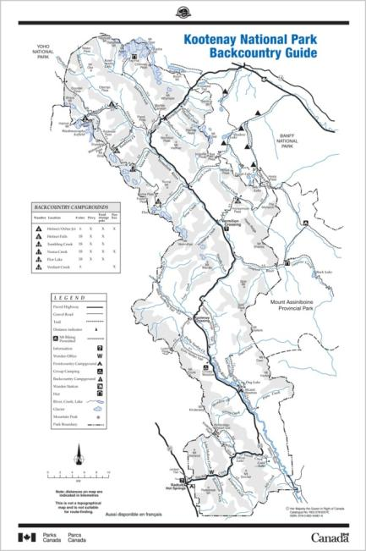
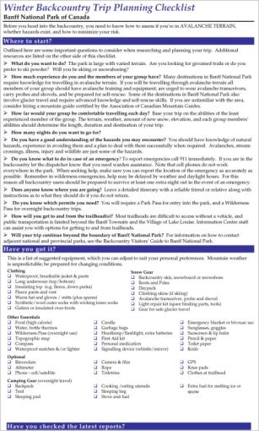
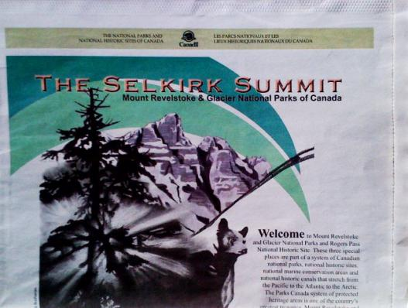
BACKCOUNTRY BROCHURE CATERGORIES
PLANNING MAP BROCHURES (6)
PLANNING NEWSPAPER (2)
ACTIVITY BROCHURES (11)
FACT SHEETS (21)
- Activity based
- Area based
- Information
CHECKLISTS (5)

Slide 12
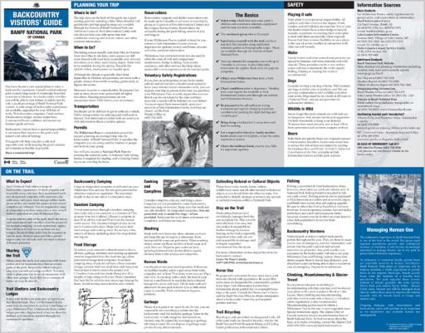

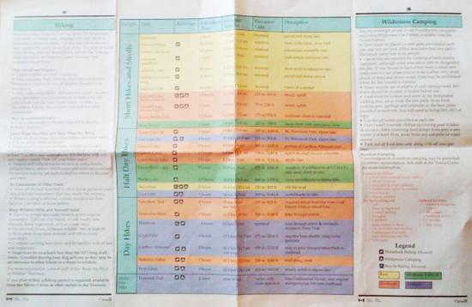
BACKCOUNTRY PLANNING MAP BROCHURES
Backcountry Visitor's Guide: Banff
Backcountry Visitor's Guide: Jasper
Backcountry Guide: Kootenay
Backcountry Guide: Yoho
Hiking – Wilderness Camping: Waterton
Recommendation Highlights
Trip planning assistance and counseling tool for visitor information staff
Design/templating for all parks
Full colour - same colour palate as the Mountain Guide, and great photos
Maps with slight mountain definition and consistent legends
User friendly design
Green options

Slide 13
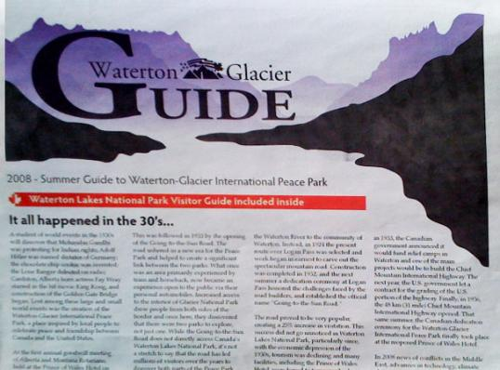
PLANNING NEWSPAPER (Backcountry Sections)
The Selkirk Summit– Mount Rev/Glacier
Waterton Glacier Guide
Recommendation Highlights
Both newspapers are a different design
Some information from both is duplicated in the Mountain Guide
Waterton Glacier Guide is professionally designed with good content and is a dual NPS publication
Selkirk Summit is poorly designed with duplicate information and should be considered replaced with a smaller more specific brochure

Slide 14
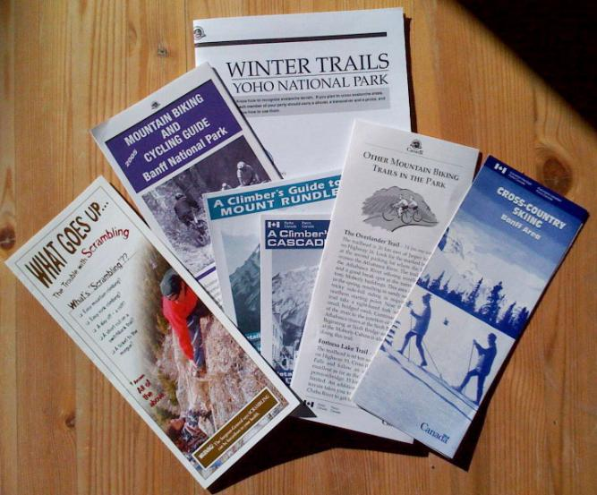
ACTIVITY BROCHURES
11 different brochures
Eg. Climbing Guide to Cascade Mountain, Mountain Biking and Cylcing Guide in in Banff, Winter Trails Yoho, etc.
Recommendation Highlights
Template design
Easy to carry pocket size
Some should be available outside the Visitor Reception Centres – e.g. climbing shops
Additional biking and snowshoeing brochures are required
Horse Users Guide brochure can be made into a fact sheet

Slide 15
CHECKLISTS
5 different checklists
Recommendation Highlights
Create two templated checklists - one for winter, one for summer. Contact information can be specific to each park.
The Wilderness Pass Pre-Trip Information
(mailed to visitors with their wilderness pass)
Update to a cleaner and simpler format.

Slide 16
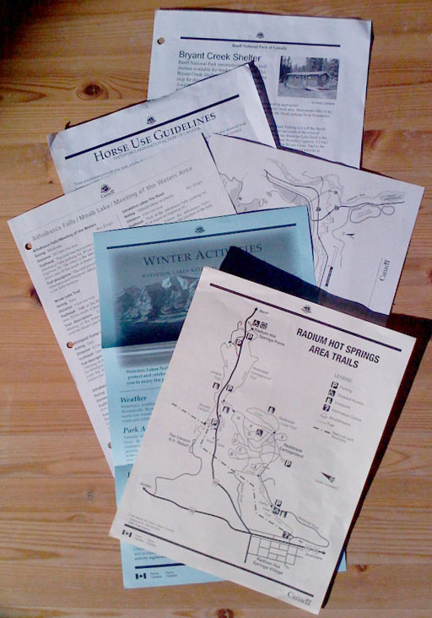
FACT SHEETS
21 different fact sheets, 21 different designs
Recommendation Highlights
Create a branded templated MS Word design that can be filled in and updated as needed by the Park staff.
Print in-house
Black and white when under 200 copies required.
Professional printing
When over 200 copies are required.
Print double sided when possible.

Slide 17

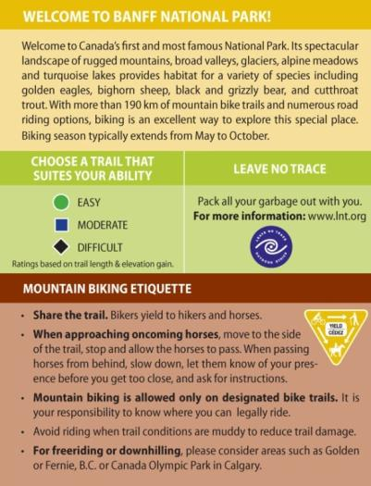
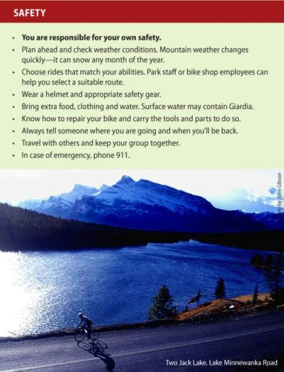
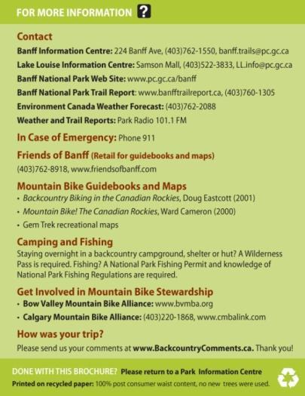
SAMPLE ACTIVITY BROCHURE MOCK-UP

Slide 18
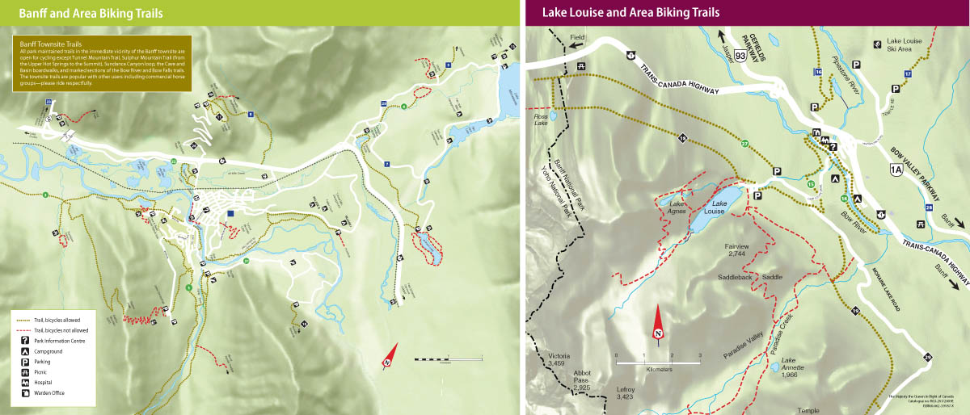
SAMPLE ACTIVITY BROCHURE MOCK-UP: MAP

Slide 19
PRINTING QUOTES FOR CURRENT BROCHURES
BNP Backcountry East, 2001 E – 15,000, F = 1,500 $4,062+GST $.25/each
BNP Day Hikes, 2006 E – 10,000, F = 600 $1,763+GST $.17/each
BNP Biking, 2005 E – 5,000, F – 500 $970 + GST $.18/each
BNP Horse Guide, 1998 E – 1,000, F – 250 $1,170+GST $.94/each
JNP Backcountry Guide, 06-07 E – 3,000, F – 300 $2,000(estimate) $.60/each
JNP Summer Trails, 2006-07 E – 35,000, F – 3,500 $5,000(estimate) $.13/each
JNP Winter Trails, 2006-07 E – 5,000, F – 500 $3,500(estimate) $.64/each
YNP Winter Trails Guide, 2008 E – 8,000, F – 1,000 $1,271+GST $.14/each
KNP Backcountry Guide, 2007 E – 15,000, F – 1,550 $1,645+GST $.10/each
Rev/Glacier Newspaper E/F – 8,000 $2,947 (inc GST) $.37/each
Waterton Glacier Guide, 2008 E –75,000 $7,030 $.09/each
Waterton Hiking Guide, 2008 E –30,000 $1,000 $.03/each
(French printed in house as needed)

Slide 20
PRINTING QUOTES*
For 10,000, colour activity brochures:
2 colour, offset 0% recycled, 70lb paper (current): $1,264
Full colour, offset 0% recycled, 70lb paper (current): $1,625
Full colour, Productolith coated, FCS Certified, 70lb paper: $1,814
Full colour, 100% recycled post consumer, 60lb paper: $1,782
*Estimated pricing only – many factors affect printing costs, prices are always changing.

Slide 21
GUIDELINES FOR PRINTING COSTS*
Save 25-40% – Reduce the amount of paper used by 50%
Save 10-15% – Use lighter paper (60lb text v.s. 100lb text)
Increase 35% – Use paper with more recycle content (100% post consumer waist vs paper with 0% post consumer waist)
Increase 35% – Use coated paper that is FSC certified (vs paper with 0% post consumer waist)
Increase 30% – Print full colour brochures instead of 2 colour brochures
Save 2% – Make sure all brochures are used before the brochure is reprinted. 200 brochures that are thrown out/recycled is a 2% loss on a 10,000 print run.
Save 5% – Print 10,000 instead of 5,000 – larger print runs will reduce your per/brochure cost. (Part of the cost of printing is the initial set-up).
*Approximate guidelines only – many factors affect printing costs, prices are always changing.

Slide 22
BROCHURE DEMAND, QUANTITY & TYPE RECOMMENDATIONS
If demand for printed information about an activity or location…
> 1,000 people per year: professionally designed and printed activity brochure should be considered.
< 1,000: internally created templated fact sheet should be considered.
If an activity is considered very dangerous but the demand is < 1,000: a professionally designed and printed brochure should be considered.
> 200 and less than 1,000, then the template fact sheet should be considered to be printed/copied professionally. Less than 200, the fact sheet should be printed in-house.

Slide 23
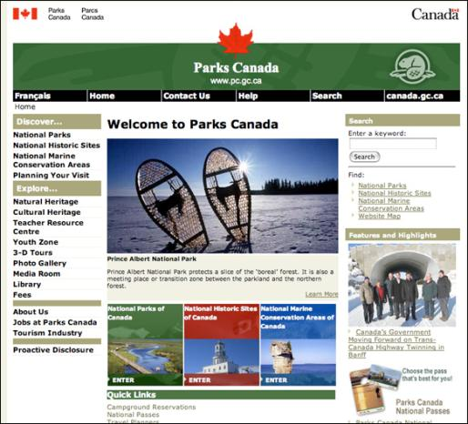
WEBSITE REVIEW
Create new content and surveys
Establish a process / terms of reference for updating the website in a timely way
Create a front page for each park that communicates what is special
Online backcountry campgrounds and trails reservations
Brochure availability
Finding information: consistencies, accuracy and intuitive navigation
User friendly design
Digital images and stories library
Notes:
Insert sample of criteria – not all are represented here . This criteria also in the handouts to be discussed after the presentation. Print out sample kiosk photos .

Slide 24
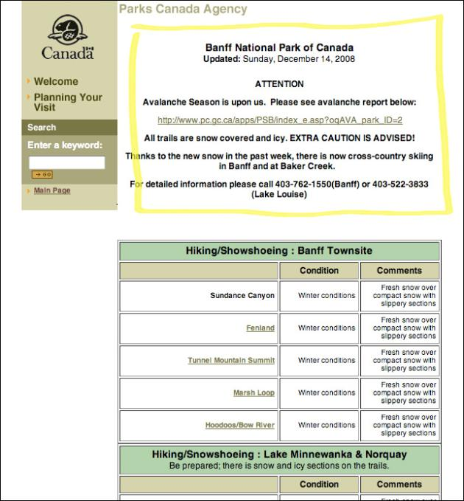
WEBSITE REVIEW: TRAIL CONDITIONS REPORT
User friendly design
Updated every 1-3 days, and date of update is indicated
Purchase and implement a user
friendly URL
Automatically bilingual
High Google ranking
Notes:
Insert sample of criteria – not all are represented here . This criteria also in the handouts to be discussed after the presentation. Print out sample kiosk photos .

Slide 25
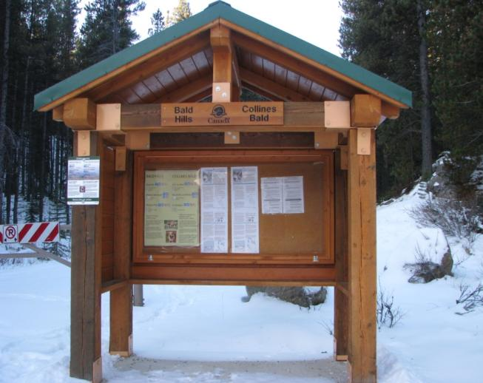
TRAILHEAD REVIEW
Inventory, interviews, design
Standard kiosk design – 2008 Guidelines
Trailhead area layout and design
Consistency and templating
Inclusions/exclusions
Sample layout for sign panels

Slide 26
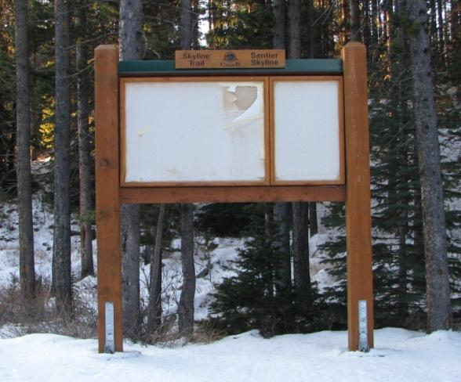
STANDARD KIOSK
  Trail and Backcountry Facility Design Guidelines
    Standard kiosk design – 2008 Guidelines
    2 designs – with or without roof
    Standard panels, plexi-glass, layout, fasteners, finish
Sign kiosk panel dimensions | Size of space | Maximum panel size
Drawing size | 42”x78.5” | 35”x74.5”
Actual size | 35”x74”
Notes:
Two standard designs
Without a roof , with a roof.
Already inconsistencies – metal bracketing, repetition in information, alternative posting preferences.

Slide 27
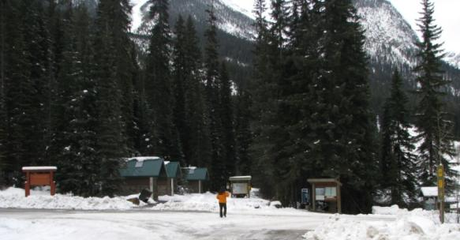
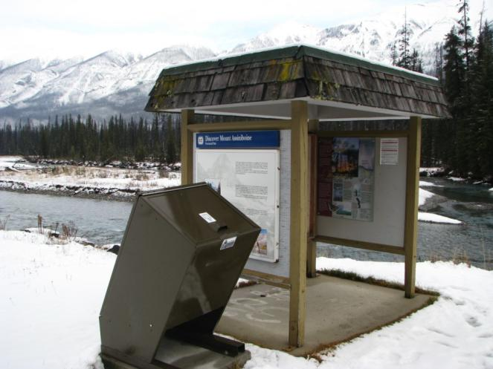
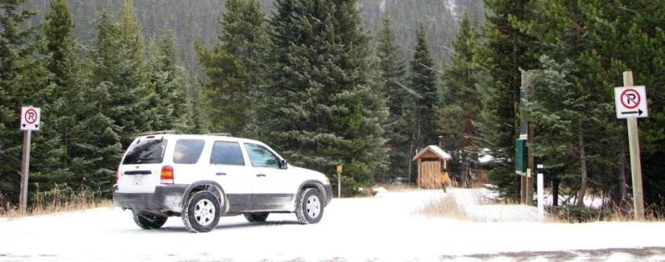
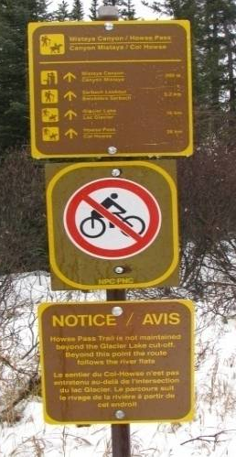
TRAILHEAD AREA LAYOUT AND DESIGN
Emerald Lake – signature gateway with 4 sign kiosks
Simpson River – BC Parks signage
Sign farming
Repetition
Cameron Lake ski trails – skier safety to address
Notes:
Emerald lake – how many kiosks = 4

Slide 28
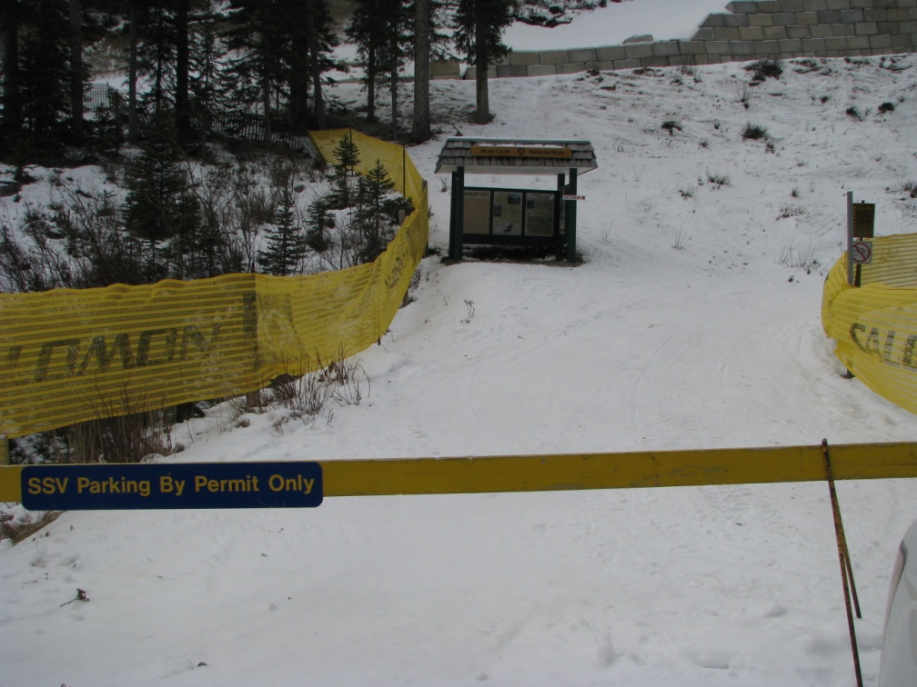
TRAILHEAD AREA LAYOUT AND DESIGN
Design gateways and entrances that celebrate the ‘front door’ of signature trails
Where do you install the new kiosk?
Are directional posts needed at the trailhead?
Use native materials for construction
Use a naturalized design style that mimics the surrounding landscape
Healy Pass trailhead at Sunshine Ski Area parking lot

Slide 29
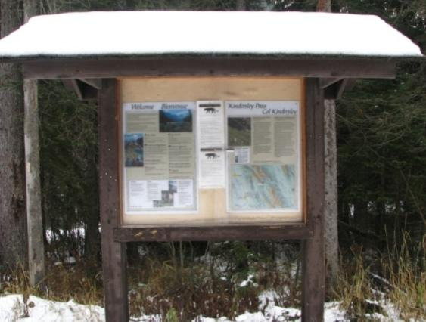
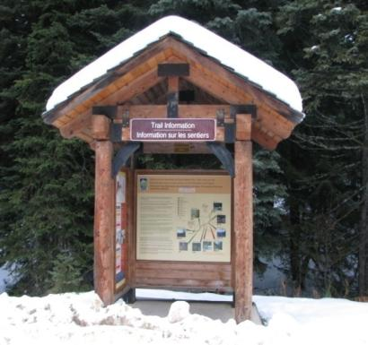
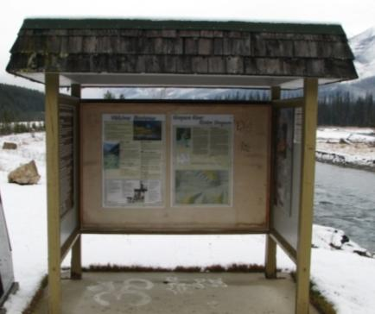
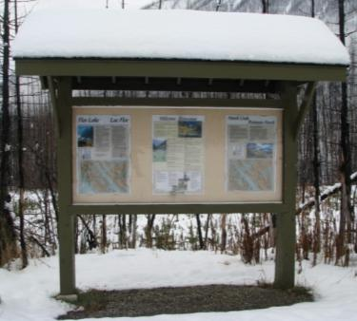
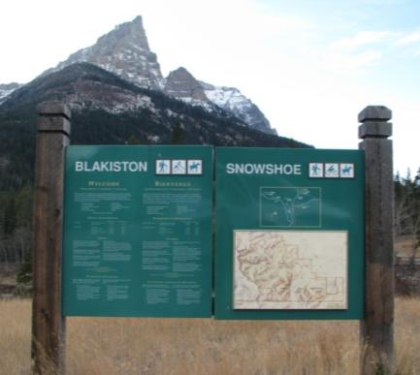
CONSISTENCY

Slide 30
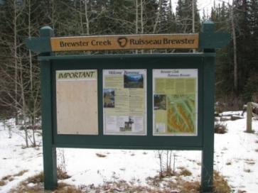
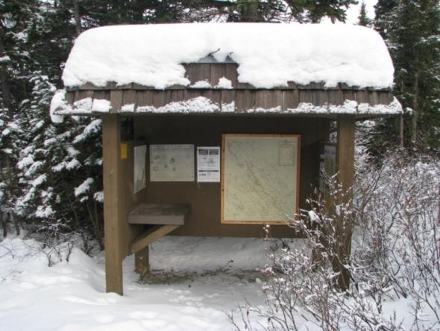
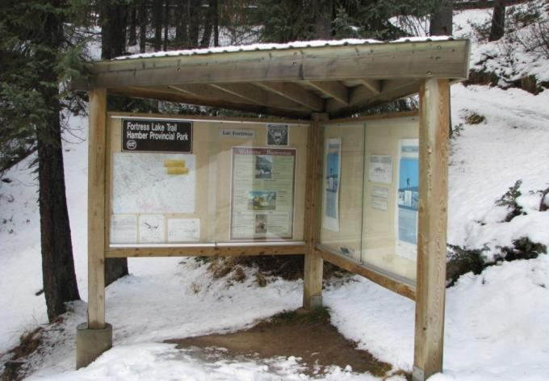
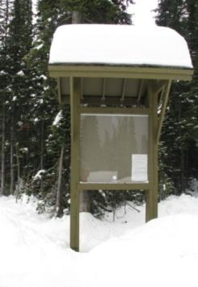
CONSISTENCY
Notes:
Variety in one park
Design, message, make up shelf

Slide 31
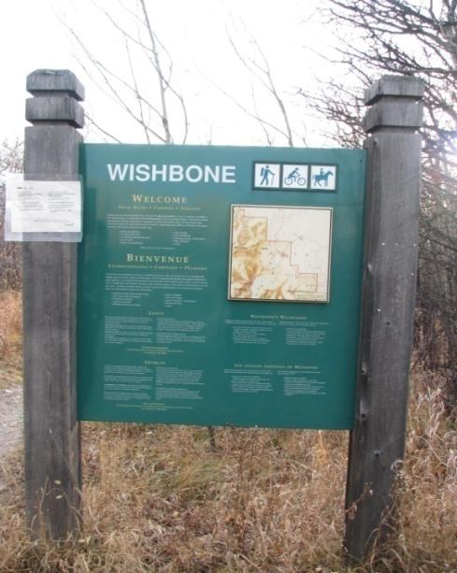
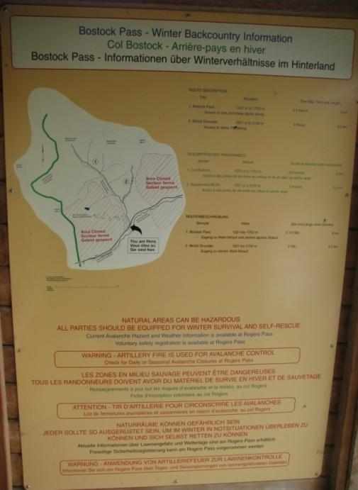
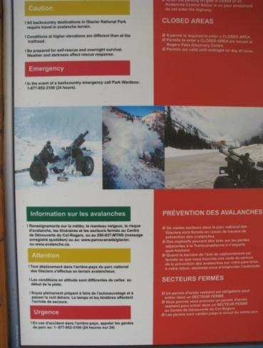
HIERARCHY, NEED FOR INFORMATION, EXCLUSIONS

Slide 32




TEMPLATING OF NOTICES AND POSTERS

Slide 33








STANDARD SYMBOLS
Notes:
International symbols
Parks standard
Consistency, in size, colour, design, mounting location, fasteners
Black & White: Waterton’s answer to US consistency – do we need to honour this style? We noted that Waterton does not always use this symbol either.
The symbols on the far right were just printed on paper and tacked up.
Blue signs: Waterton’s Kiosk signs

Slide 34


DESIGN GUIDELINES FOR TRAILHEAD KIOSKS

Slide 35

DESIGN GUIDELINES FOR TRAILHEAD KIOSKS
Simplify the message
LESS, LESS, LESS

Slide 36
SIGN PANEL LAYOUT AND DESIGN
MAP – 3D, simple, Gem Trek
TRAIL DESCRIPTION – Distance, elevation gain, short description, photo
SAFETY MESSAGE – ‘Be responsible for your own safety’ poster, emergency contact information.
USER SYMBOLS
TEMPLATED NOTICES – Standard for all parks, dated, updated.
INFORMATION = GREEN e.g. Mountain Caribou, fish stocking, trail grooming
CAUTION = YELLOW e.g. fallen trees over trail area
CLOSURE = RED e.g. trail closed due to bear activity
CUSTOM MESSAGE – Specific park/trail information.
EXCLUSIONS
Park management issues, interpretive messages, volunteer group information.
Notes:
Two standard designs
Without a roof , with a roof.
Already inconsistencies – metal bracketing, repetition in information, alternative posting preferences.

Slide 37

SIGN KIOSK SAMPLE LAYOUT

Slide 38


Slide 39

APPROACH TO SUCCESS
STEERING COMMITTEE
Continue coordination of future stages of the backcountry media projects
DESIGN GUIDELINES
The new media suite development
COMMUNICATION
Intranet library, “How To” guidelines
USER SURVEYS, FEEDBACK and OBSERVATIONS
Ongoing survey results, URL feedback, remote observations

Slide 40

THE NEXT PHASES
2009 PROJECT PRIORITIES
1st priority
Strike Steering Committee and appoint lead
Complete park investigative work, set Park priorities
Develop design guidelines
(to be defined and refined in conjunction with
media design for 2nd and 3rd priority projects).
2nd Priority
Design and fabricate sample trailhead kiosk panels
(at installed new Jasper kiosks)
3rd Priority
Determine priority brochures (one or two)
Design and print new media products.
Template fact sheets, and checklists.
4th Priority
Website upgrade
Build intranet library
(Although of high importance, this project needs to await the new brand initiation)

